Slide 1
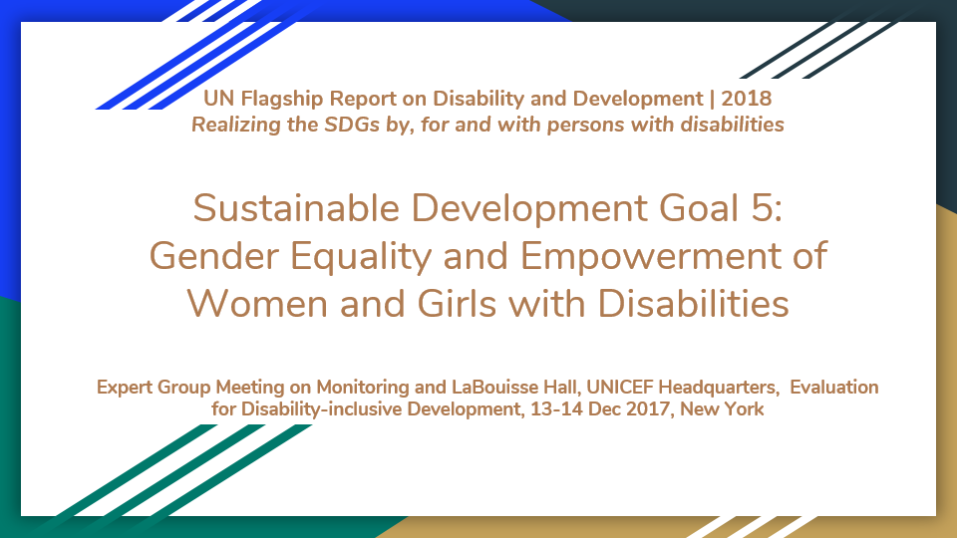
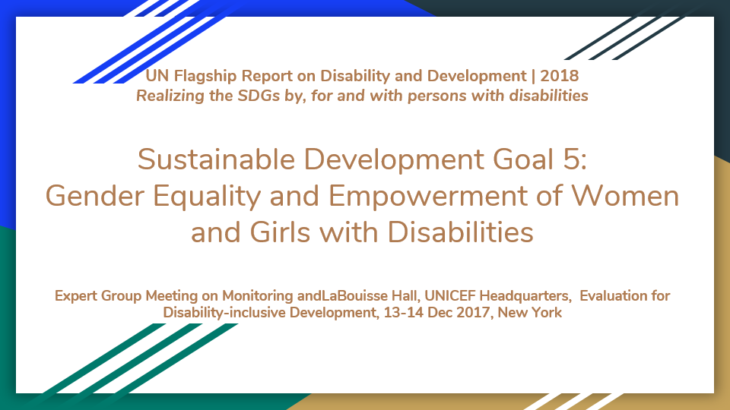
UN Flagship Report on Disability and Development | 2018
Realizing the SDGs by, for and with persons with disabilities
Sustainable Development Goal 5:
Gender Equality and Empowerment of Women and Girls with Disabilities
Expert Group Meeting on Monitoring and LaBouisse Hall, UNICEF Headquarters, Evaluation for Disability-inclusive Development, 13-14 Dec 2017, New York

Slide 2
Overview
Task Team
Process, gaps, and challenges
Content and Findings
Way Forward

Slide 3
Task Team Coordinators
Ola Abu Alghaib, Leonard Cheshire Disability
Maribel Derjani-Bayeh, UN Women

Slide 4
Task Team Members
Organizations of women with disabilities and other women’s organizations
Carolyn Frohmader, Women With Disabilities Australia (WWDA)
Emma Pearce, Women’s Refugee Commission
Freyja Haraldsdóttir, TABU (grass-roots feminist women’s group in Iceland)
Mijoo Kim, Korea Disability Law Association / Women with Disabilities Arts and Cultural Network

Slide 5
Task Team Members
Organizations of persons with disabilities
Mary Keogh, Christian Blind Mission (CBM)
Hannah Loryman, SightSavers
Sophie Pecourt, Handicap International Making It Work project

Slide 6
Task Team Members
Academic organizations and others
Mona Paré, University of Ottawa
Rannveig Traustadóttir, University of Iceland
Maria Soledad Cisternas Reyes, former Chair of the Committee on the Rights of Persons with Disabilities

Slide 7
Task Team Members
United Nations
Heidi Ullmann, United Nations Economic Commission for Latin America and the Caribbean (ECLAC)
Victoria Lee, Office of the High Commissioner for Human Rights
Other contributions: Emily Rubin, Intern, UN Women

Slide 8
Process, gaps, and challenges

Slide 9
Process, gaps, and challenges
Looked at interlinkages between the targets of SDG 5 and other SDGs and chapters in the report
Decided to address areas less likely to be addressed by other chapters
Most input received addressed sexual and reproductive health and violence against women to be addressed in another chapter
Sources included a few peer reviewed articles, and mostly research and publications produced by task team members or their organizations.
Much of the evidence is qualitative
Additional research: peer reviewed articles for the situation, and State Party reports for practices

Slide 10
Audience and focus of the chapter
Audience:
Those working in the areas of
Rights and inclusions of persons with disabilities
Gender equality and empowerment of women and girls
Tried to:
Organize the information around the targets of SDG 5 to better understand what we know about women and girls with disabilities compared to other women and girls
Address the development and humanitarian continuum.

Slide 11
Would like your feedback on
Noting the concerns with and gaps in evidence/information
Whether to:
Work with the evidence we have, including input to the prototype??
Focus on thematic areas where information is available?
Look for additional quantitative data/evidence in UN and other international/regional organizations?

Slide 12
Options to collaborate and coordinate with other task teams
Whether and how gender perspectives are being addressed in other chapters / under other SDGs
Evidence or sources of evidence other teams can share as input for the chapter on SDG 5

Slide 13
SDG 5: Targets and Interlinkages

Slide 14
SDG 5: Targets and Interlinkages
5.1 End all forms of discrimination against all women and girls everywhere
Also related to the chapter SDG10 on inequalities
Could also be addressed in all other chapters highlighting
Any information available but not included in the chapter
Good practices, and/or challenges including disaggregation by sex, age and disability

Slide 15
SDG 5: Targets and Interlinkages (continued)
Proposed areas of focus:
5.5 Ensure women’s full and effective participation and equal opportunities for leadership at all levels of decision-making in political, economic and public life
  Also related to the chapter on SDG 16: 16.7 Ensure responsive, inclusive, participatory and representative decision-making at all levels

Slide 16
SDG 5: Targets and Interlinkages (continued)
Proposed areas of focus (continued)
5.4 Recognize and value unpaid care and domestic work through the provision of public services, infrastructure and social protection policies and the promotion of shared responsibility within the household and the family as nationally appropriate
  Also related to chapters on SDG 8 employment, and SDGs 1&2 social protection, and SDG 11 Accessible and inclusive cities and human settlements.

Slide 17
SDG 5: Targets and Interlinkages (continued)
Proposed areas of focus (continued):
5.a Undertake reforms to give women equal rights to economic resources, as well as access to ownership and control over land and other forms of property, financial services, inheritance and natural resources, in accordance with national laws
  Also related to the chapters addressing employment, social protection, poverty and hunger, SDGs 6 and 7 on water and sanitation and energy

Slide 18
SDG 5: Targets and Interlinkages (continued)
Coordination with other task teams
5.2 Eliminate all forms of violence against all women and girls in the public and private spheres, including trafficking and sexual and other types of exploitation
5.3 Eliminate all harmful practices, such as child, early and forced marriage and female genital mutilation
  Will be addressed in the chapter of ensuring access for persons with disabilities to sexual and reproductive health and reproductive rights
  Could also be addressed in the chapters on violence and access to justice, and disasters, humanitarian crisis and climate change.

Slide 19
SDG 5: Targets and Interlinkages (continued)
Coordination with other task teams (continued).
5.6 Ensure universal access to sexual and reproductive health and reproductive rights as agreed in accordance with the Programme of Action of the International Conference on Population and Development and the Beijing Platform for Action and the outcome documents of their review conferences
  Will be the focus of the chapter of ensuring access for persons with disabilities to sexual and reproductive health and reproductive rights

Slide 20
SDG 5: Targets and Interlinkages (continued)
Coordination with other task teams (continued).
5.b Enhance the use of enabling technology, in particular information and communications technology, to promote the empowerment of women
  Could be addressed in the chapters on ICTs / Assistive Devices, and Means of implementation: International cooperation, capacity building, technology and partnerships.

Slide 21
Introduction to the topic

Slide 22
Introduction to the Topic
In The 2030 Agenda resolves to
  Achieve gender equality and empowerment of all women and girls
  Explicitly recognizes need to empower persons with disability
  Increase in investments to close the gender gap and strengthen support for institutions in relation to gender equality and the empowerment of women.
The 2030 Agenda
  Opportunity to for the empowerment of women and girls with disabilities
  Most targets with specific references to disability also include reference to gender/women/sex

Slide 23
Introduction to the topic (continued)
Tried to address
  Other areas of intersectionality: Age, ethnicity, refugee status, urban/rural.
  Gender equality: Women and girls with disabilities and men and boys with disabilities
  Empowerment of women: women with disabilities compared to other women

Slide 24
International Normative Framework

Slide 25
International normative framework
CEDAW, CRPD, CRC, and other human rights treaties
General Comments and Recommendations
Beijing, 2030 Agenda
Outcomes of global conferences
New Urban Agenda, Addis Ababa Action Agenda
Sendai Framework for Disaster Risk Reduction
Charter on the Inclusion of Persons with Disabilities in Humanitarian Action

Slide 26
International normative framework (continued)
Selected United Nations resolutions
General Assembly, Human Rights Council, Security Council, and Economic and Social Council, including
  Implementation of the Convention on the Rights of Persons with Disabilities and the Optional Protocol thereto: situation of women and girls with disabilities
Commission on the Status of Women Agreed Conclusions including 2013, 2016, 2017

Slide 27
International normative framework (continued)
Regional Conventions, Strategies and Plans
Inter-American Convention
Continental Plan for African Decade
Incheon Strategy
European Strategy

Slide 28
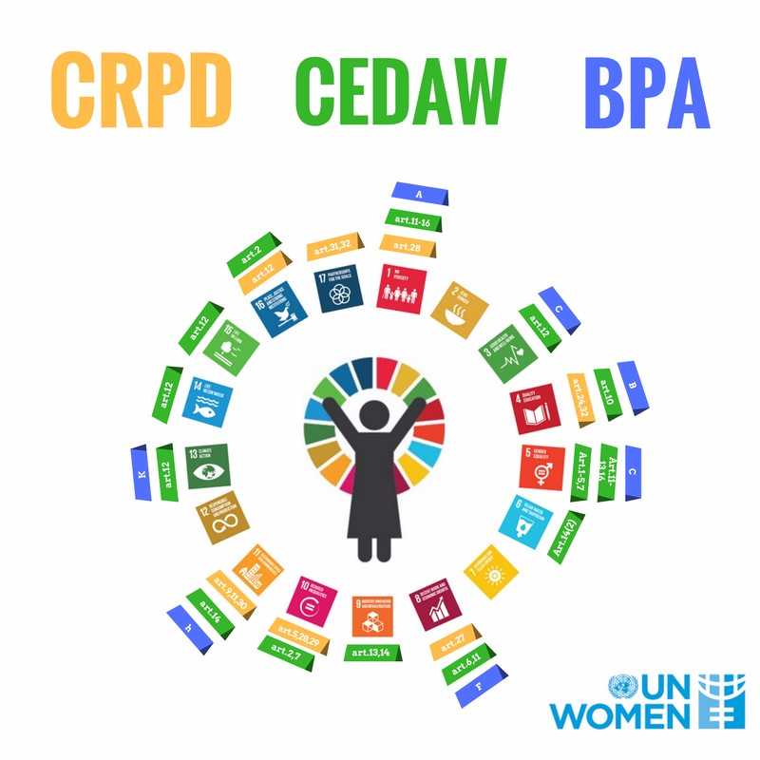

Slide 29
Situation of Women and Girls with Disabilities
Status and Trends

Slide 30
5.1 End all forms of discrimination against all women and girls everywhere
Intersection of gender and disability
  Women and girls with disabilities face greater discrimination and exclusion from society than women without disabilities, and men with disabilities.

Slide 31
5.1 End all forms of discrimination against all women and girls everywhere (continued)
These manifest in
  Education, employment, income, access to health services, including gynaecological services
  Marriage, autonomy over sexual and reproductive health and rights.
  Sports, coverage in the media, etc.
  Higher incidence of violence and abuse (gender based?)
  Note: Evidence varies by type of disability, and other factors such as ethnicity, age.

Slide 32
5.4 Recognize and value unpaid care and domestic work through the provision of public services, infrastructure and social protection
Women and girls with disabilities
  Less likely to be employed
  More likely to be underemployed (working part time instead of full time)
  Older women with disabilities face even higher rates of un/under employment.

Slide 33
5.4 Recognize and value unpaid care and domestic work through the provision of public services, infrastructure and social protection (continued)
Women with disabilities are more likely to be economically unstable than men with disabilities, and women without disabilities
  More likely to live in poverty
  Often rely on government support to supplement income
  More likely to face housing insecurity and homelessness
  Access to fewer resources and support networks
  Overall lower quality of life

Slide 34
5.5 Ensure women’s full and effective participation and equal opportunities for leadership
Limited disaggregated data available on women with disabilities in political leadership roles
Often where women with disabilities are represented in parliament, it is as a result of quote systems where both persons with disabilities and/or women are given certain numbers of seat allocations.
Without adequate representation of women with disabilities, their voices and experiences are not adequately reflected.

Slide 35
Good practices and policy trends

Slide 36
Good practices and policy trends
Overview
Not a very clear trend or impact
Inclusion of women among other women groups of women or population groups
Mainstreaming of gender in initiatives related to the inclusion of persons with disabilities
Disability inclusion gender equality and empowerment of women
Initiatives targeting women and girls with disabilities

Slide 37
Good practices and policy trends
State Parties
Still reviewing the information from State Party reports to the Committee on the Rights of Persons with Disabilities
Opportunities for women with disabilities to access loans and allowing repayment installments (Thailand)
Some States include gender equality and empowerment of women in their strategies and/or frameworks for the inclusion of persons with disabilities in international cooperation (including Australia and the United Kingdom)

Slide 38
Good practices and policy trends (continued)
Civil Society Organizations, including Organizations of Women with Disabilities
Handicap International: Making It Work Initiative on good practices to address violence against women with disabilities
Women Enabled International: Mapping and support to and capacity building of grassroots organizations
Women’s Refugee Commission: Strengthening Networks of Women with Disabilities in Humanitarian Action
Mobility International USA: Leadership: Women’s Institute on Leadership and Disability (WILD)

Slide 39
United Nations activities

Slide 40
United Nations Activities
UNICEF: Address barriers girls with disabilities face in access to Water, Sanitation and Hygiene (Cambodia, Jordan,
Tanzania)
UNDP: Engagement of women with disabilities in development policy making (Turkmenistan).
UNFPA: Global initiative WE DECIDE to promote gender equality and advocate for the end of sexual violence

Slide 41
United Nations Activities (continued)
UN Women, supported
Support participation of women, youth and persons with disabilities to participated in electoral processes, including as candidates (Tanzania)
Including gender perspectives in s disability policy (Morocco)
Participation of women with disabilities in the development of the National Action Plan for Security Council resolution 1325, and propose disaggregation by disability (Colombia).

Slide 42
Concluding remarks

Slide 43
Concluding remarks
Increased attention to issues related to violence against women with disabilities and sexual and reproductive health
Gaps remain
Most initiatives reported mention women and girls with disabilities, but it is not if these:
              Benefit women and /or girls
        Target women and/or girls
        Address gender equality

Slide 44
Concluding remarks (continued)
Gaps remain
Available data and evidence:
  Rarely analysed and reported by sex and disability,
  Most either on persons with disabilities or women
Evidence on thematic areas, in particular under SDG 5

Slide 45
Way forward

Slide 46
Way forward
Include:
Increased participation, leadership and empowerment of women and girls with disabilities
Improved data disaggregation on gender, disability and age
Disability and gender mainstreaming in policy development, financing and implementation
Development of a gender and disability monitoring mechanism – cross cutting issues across other goals.
Strong political will

Slide 47
Comments and Questions

Slide 48
Thank you

Slide 50
5.2 Eliminate all forms of violence against women and girls.
Women and girls with disabilities are at a heightened risk of physical, sexual and emotional violence than women without disabilities and men with disabilities.
  Unequal power relations
  Perception that women and girls with disabilities are unable or unwilling to reveal abusers
  Devalued sense of self
Women with disabilities who experience violence often do not seek either treatment or redress
  Fear of stigma
  Retaliation
  Lack of awareness of rights
  Often financially or emotionally dependant on their abusers
  Lack alternative living arrangements

Slide 51
5.2 Eliminate all forms of violence against women and girls.(cont’d)
Women and girls with disabilities are at a heightened risk of physical, sexual and emotional violence than women without disabilities and men with disabilities.
Abuse can often come from
  Family members
  Care givers
  Romantic partners
  Health care workers
  Strangers
Abuse can occur when women with disabilities are perceived to be the most vulnerable
Home
In the street
Seeking medical treatment
During pregnancy
Institutional settings

Slide 52
5.3 Eliminate all harmful practices, such as child, early and forced marriage, and female genital mutilation
Women and girls with disabilities are at a heightened risk of physical, sexual and emotional violence than women without disabilities and men with disabilities.
Abuse can often come from
  Family members
  Care givers
  Romantic partners
  Health care workers
  Strangers
Abuse can occur when women with disabilities are perceived to be the most vulnerable
Home
In the street
Seeking medical treatment
During pregnancy
Institutional settings

Slide 53
5.3 Eliminate all harmful practices, such as child, early and forced marriage, and female genital mutilation.(cont’d)
Women with disabilities are forced to undergo unwanted medical procedures
  Forced sterilization; Surgically, or through menstrual suppressing drugs
  Electrotherapy
Women with emotional distress or mental illness often have difficulty accessing much needed treatment and support.
They often end up incarcerated or institutionalized
  Denied basic human rights
  Greater risk of violence from guardians, other patients/inmates
  Segregated from general population
  Face isolation, excessive forced interventions, coercion, retaliation

Slide 54
5.6 Ensure universal access to sexual and reproductive health and reproductive rights. (SDG 3.7, 5.6)
Women with disabilities are viewed as being asexual, or incapable of making informed decisions regarding their sexual and reproductive health.
  Often receive little to no sexual and reproductive health education
  Lack of accessible health care and services
Inaccessible facilities- distance, lack of accommodations for women with physical impairments.
Lack of training for professional staff
Women with disabilities often denied access to general health care
  Bias from family members, health care workers
  Lack of accessible facilities
  Lack of knowledge of available services

Slide 55
5.6 Ensure universal access to sexual and reproductive health and reproductive rights. (SDG 3.7, 5.6) Cont’d
Women with disabilities are subject to higher mortality rates from treatable diseases
  Breast and cervical cancers
Women with disabilities are more likely to be single mothers, and more likely to have children removed from their care

